Slide 1
A Gentle Start
Let us begin our mathematical analysis by showing how successful learning can be achieved in a relatively simplified setting.

Slide 2
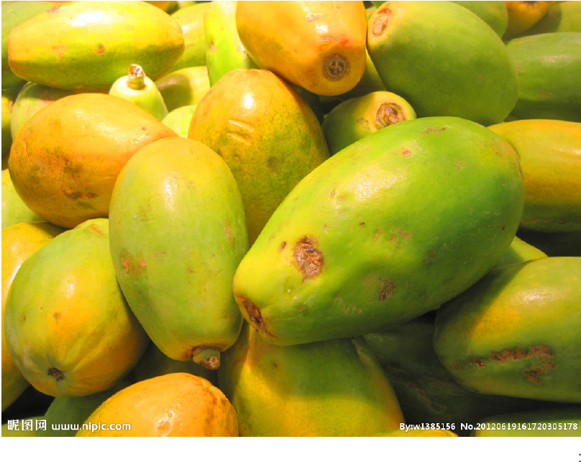
Imagine you have just arrived in some small Pacific island. You soon find out that papayas are a significant ingredient in the local diet. However, you have never before tasted papayas.
You have to learn how to predict whether a papaya you see in the market is tasty or not.
you need to decide which features of a papaya your prediction should be based on.
On the basis of your previous experience with other fruits, you decide to use two features:
the papaya’s color, ranging from dark green, through orange
red to dark brown, and the papaya’s softness, ranging from rock hard to mushy.

Slide 3
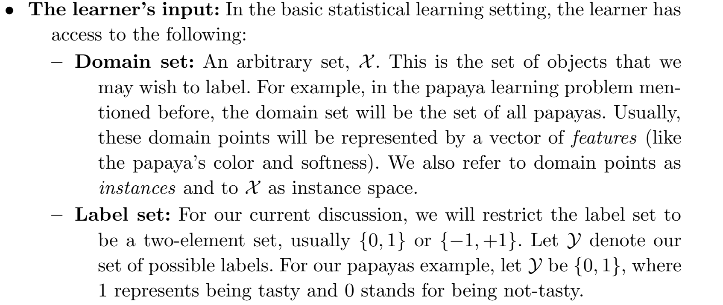
A Formal Model: The Statistical Learning Framework

Slide 4
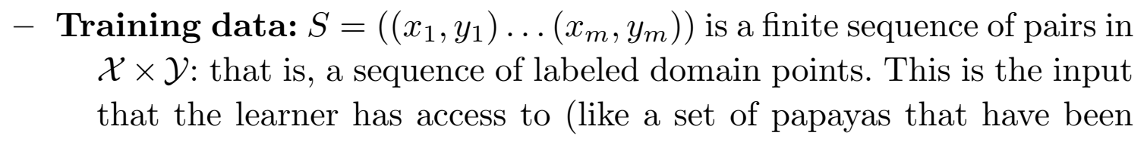
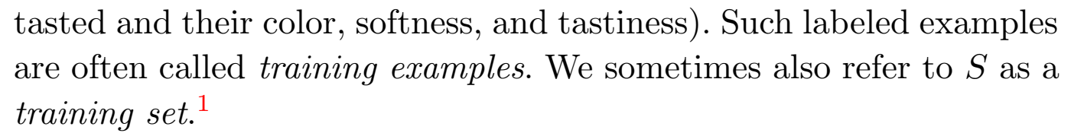
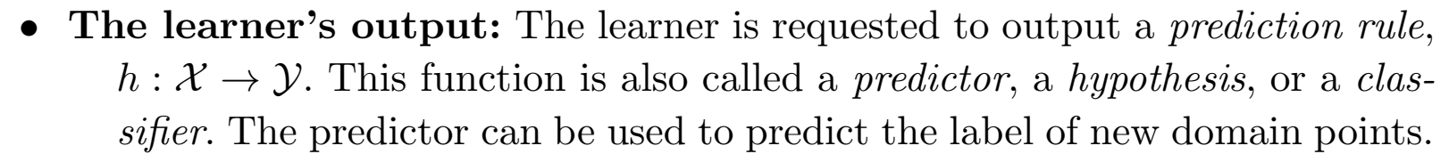

Slide 5
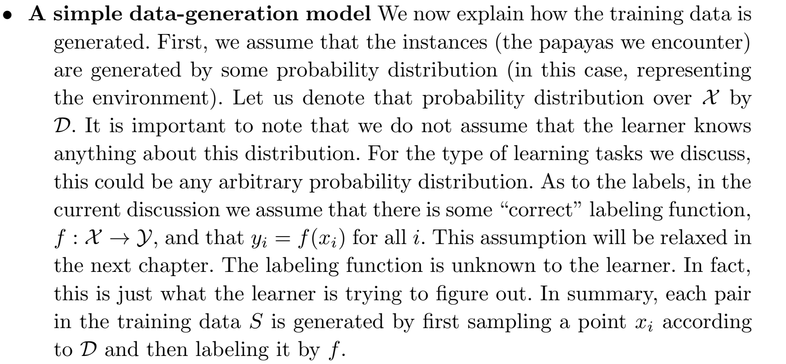

Slide 6
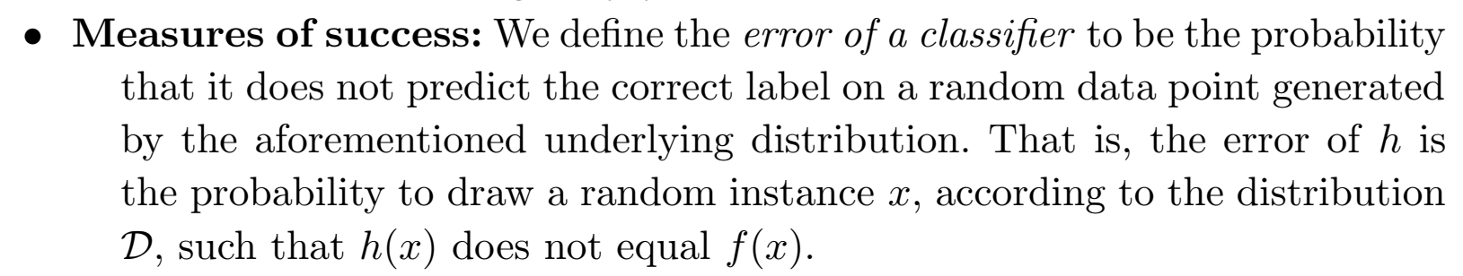
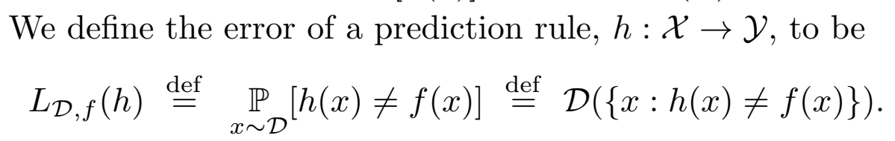
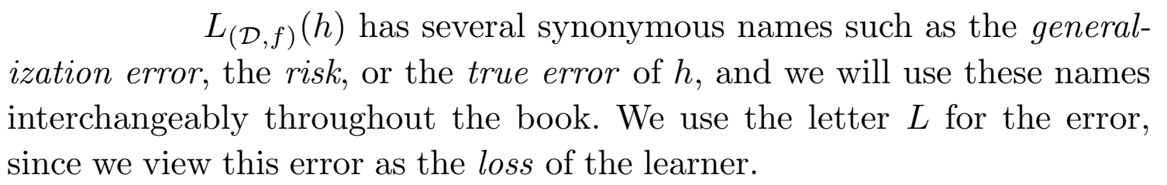

Slide 7
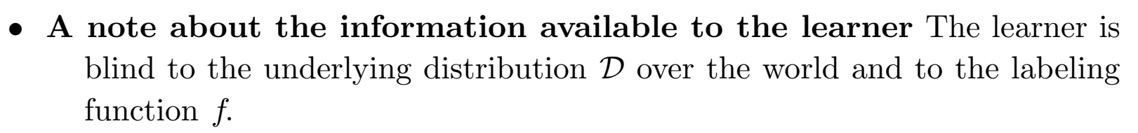
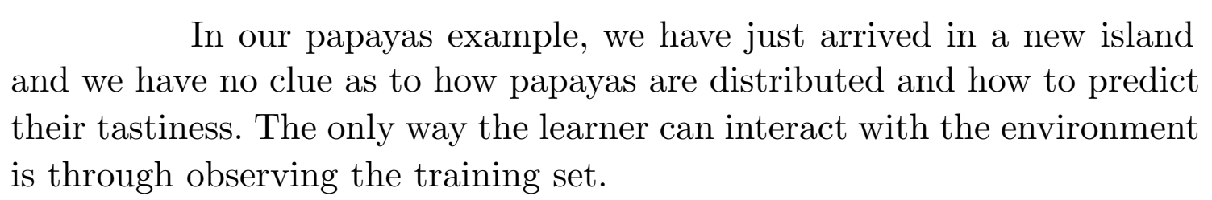

Slide 8

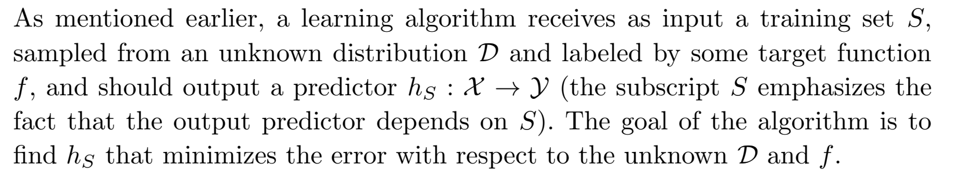
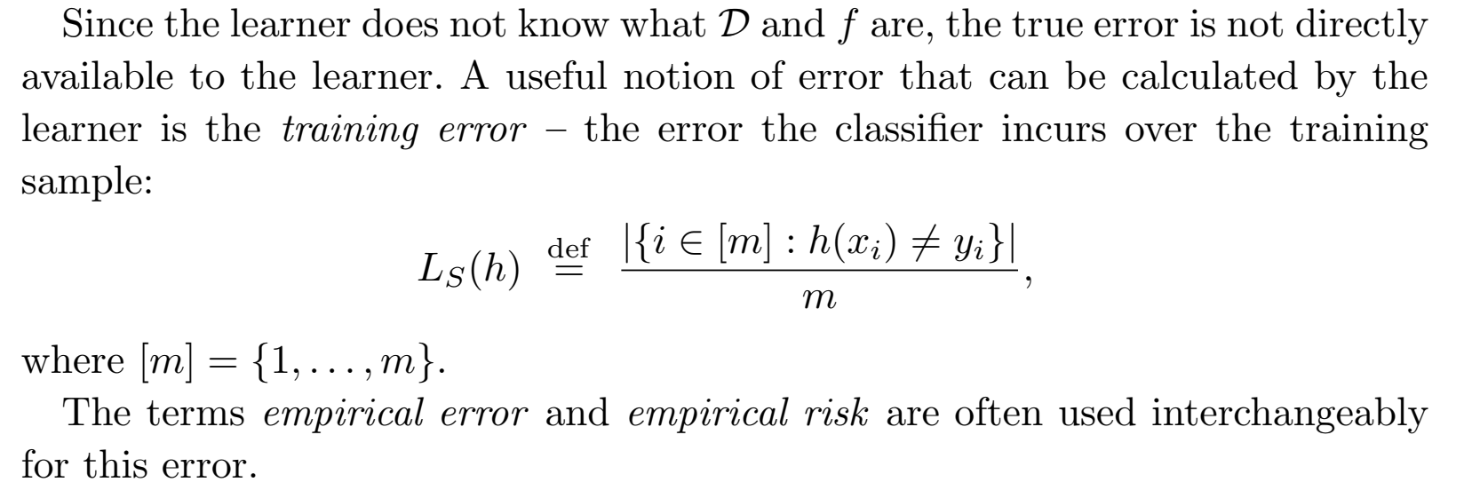

Slide 9
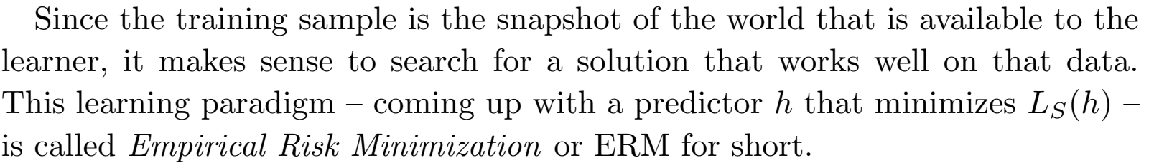

Slide 10
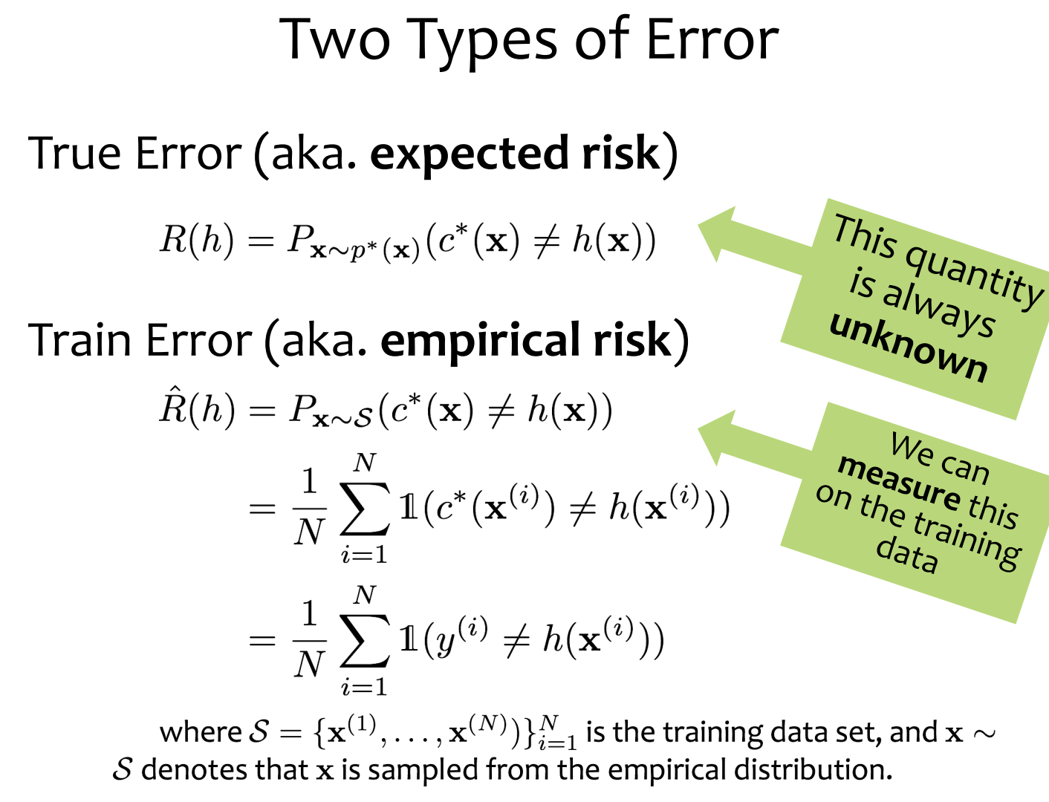

Slide 11
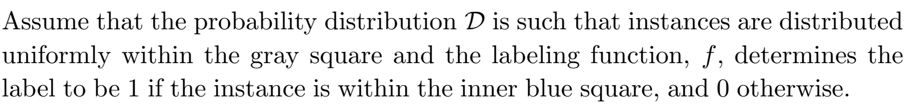
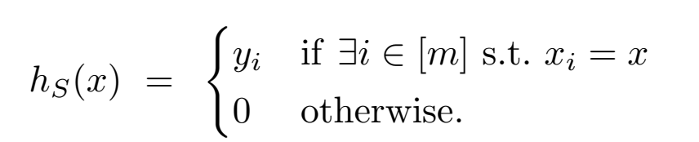
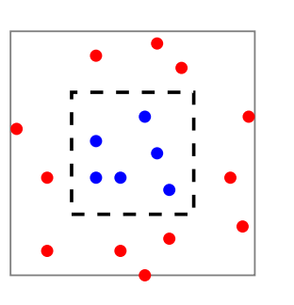




Slide 12
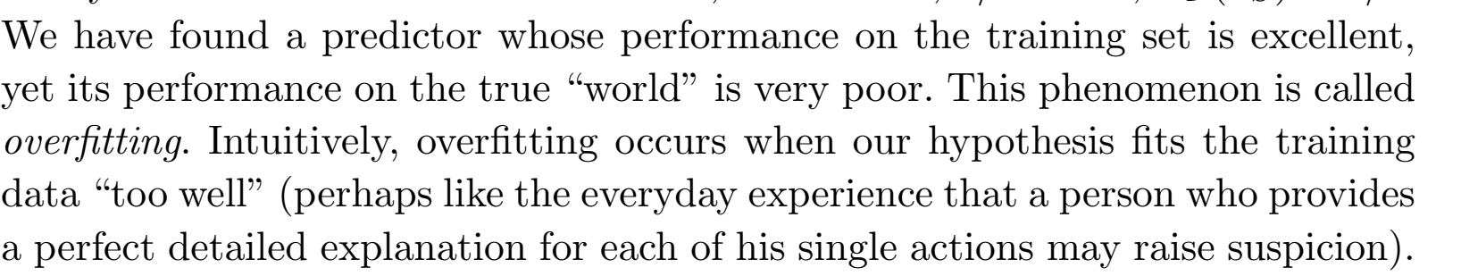
Overfitting
Underfitting: neither model the training data nor generalize the new data.

Slide 13

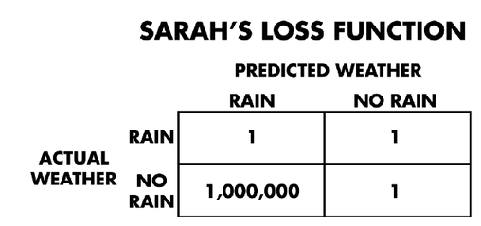
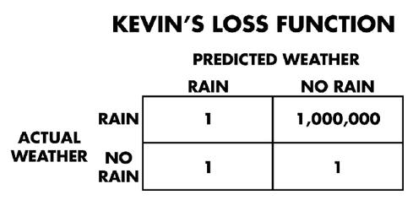
Empirical Risk Minimization Example
f: Sky → Weather
Kevin hates getting rained on.
Sarah hates to carry an umbrella.

Slide 14
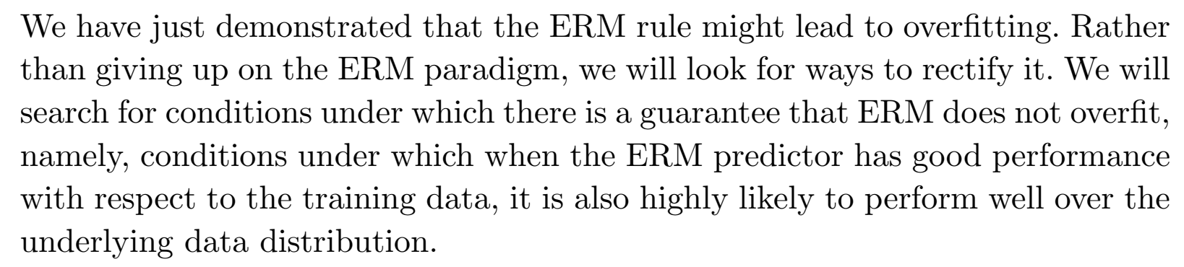
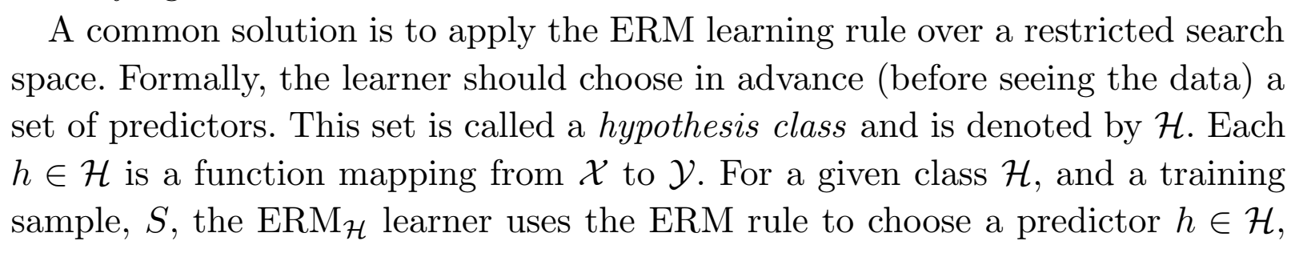

Slide 15
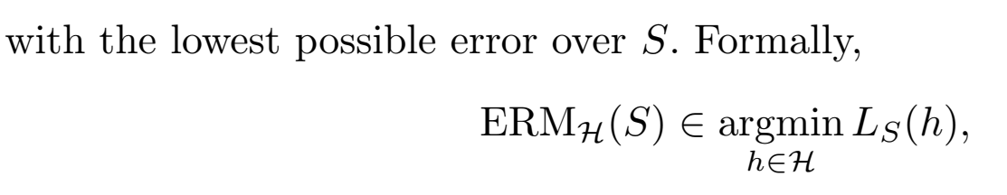
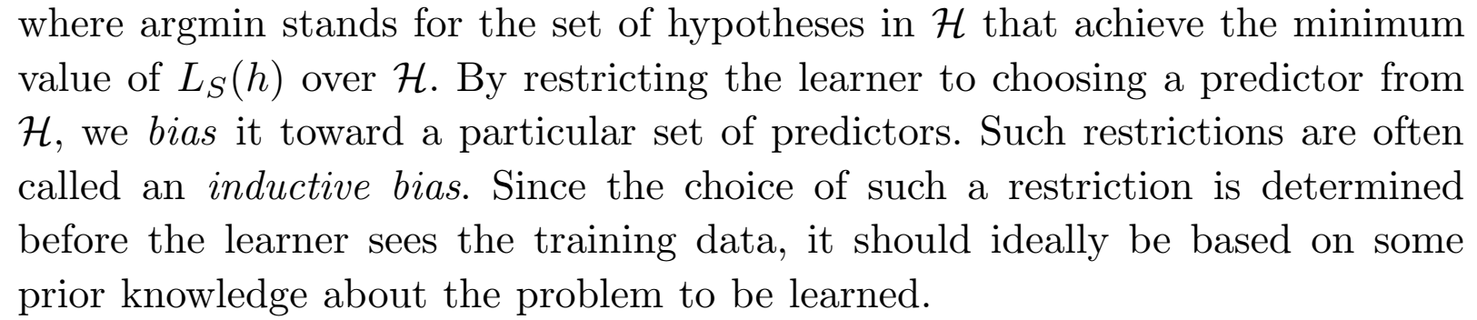

Slide 17
Empirical Risk Minimization is a part of _____________ [A]
Supervised learning
Unsupervised Learning
Reinforcement Learning
All of the mentioned

Slide 18
Is it possible to train a hypothesis on the each possible instance of a class. [no]
Yes
No

Slide 19
Observer has no idea about the _______
[B]
Distribution of example
Actual target function
A and b
None of the mentioned

Slide 20
Which of the following Quantity is always unknown? [A]
True Error
Train Error

Slide 21
Thank You !!!

